Slide 1
INTRODUCTION TO PATENT DOCUMENT
LAUNCH OF MASENO TISC CENTRE AND IP TRAINING
18TH TO 20TH AUGUST 2021
Cleophas Ojode cleojode@yahoo.com

Slide 2
PATENT DOCUMENT
Patent document comprises all information which:
Has been published in a patent document
Can be derived from analyzing patent filing statistics

Slide 3
PATENT DOCUMENT
Patent document includes:
Technical information-from the description and drawings of the invention
Legal information- from the patent claims defining the scope of the patent and
- from its legal status
Business-relevant information- from reference data identifying the inventor, date of filing, country of origin etc.

Slide 4
PARTICULAR INFORMATION FOUND IN PATENT DOCUMENT
Applicant- name of the individual or company applying to have a particular invention protected
Inventor- name of the person (s) who invented the new technology or developed the invention
Description- Clear and concise explanation of known existing technologies related to the new invention
And explanation of how this invention could be applied to solve problems not addressed by the existing technologies;
Specific embodiments of the new technology are also given

Slide 5
PARTICULAR INFORMATION FOUND IN PATENT DOCUMENT
Claims- Legal definition of the subject matter which the applicant regards as his invention and for which protection is sought or granted
Each claim defines the scope of protection of an invention and its unique features
Claims must be clear and concise and fully supported by the description

Slide 6
PARTICULAR INFORMATION FOUND IN PATENT DOCUMENT
Priority filing- Original first filing on the basis of which further successive national, regional or international filings can be made within the priority period of one year
Priority date - Date of the first filing from which the invention is protected if the application is successful and from which the one-year priority period for further application starts,

Slide 7
PARTICULAR INFORMATION FOUND IN PATENT DOCUMENT
Filing date -date of submitting an individual patent application at a particular patent office, hence the date from which the invention is protected if the application is successful
Designated states- if the application is regional or international, the countries to which the rights may be extended.

Slide 8
PARTICULAR INFORMATION FOUND IN PATENT DOCUMENT
Legal status- indicates whether the patent has been granted or not
If granted, the countries or regions in which the patent has been granted
Whether it is still valid or has expired or been invalidated in a particular country or region

Slide 9
PARTICULAR INFORMATION FOUND IN PATENT DOCUMENT
Citations and references
Certain patent documents also include references to related technology information uncovered by the applicant or patent examiner during patent granting procedure
These references and citations include both patent and non-patent documents

Slide 10
PARTICULAR INFORMATION FOUND IN PATENT DOCUMENT
Bibliographic data - Refers to the various data appearing on the front page of a patent document or the corresponding applications and may comprise:
Document identification data
Domestic filing data
Priority data, publication data
Classification data

Slide 11
PARTICULAR INFORMATION FOUND IN PATENT DOCUMENT
Document kind codes- Used to distinguish published patent documents according to type and status e,g
Code A1-denotes a published application complete with ISR ( International Search Report)
Code A2 indicates a published application without an ISR
Code A3 designates an ISR published separately from an application
Country codes- specify different countries by a unique two-letter country code( KE-for Kenya)

Slide 12
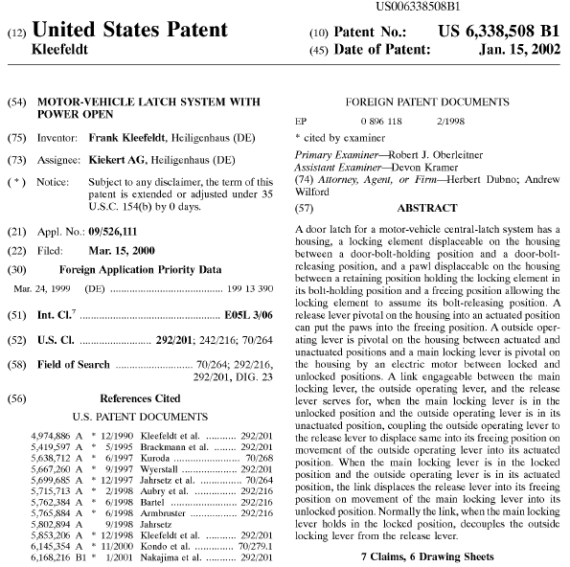
Patent Application Document

Slide 13
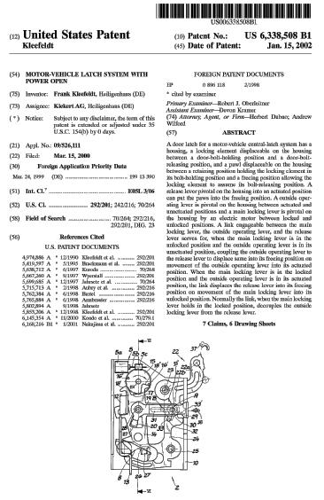
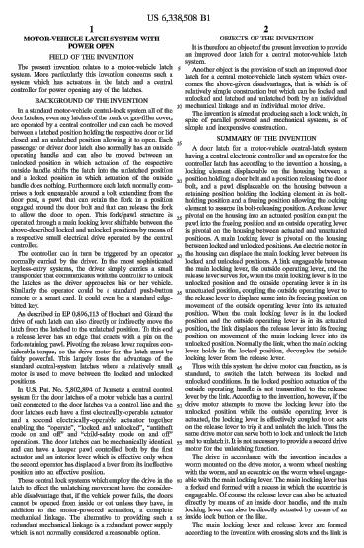
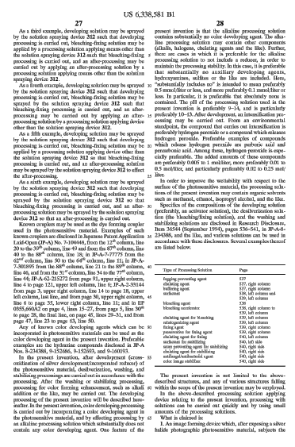
Patent Documents
Bibliography
Description
Representative
Drawing
Claims
(Info. of Rights)

Slide 14
US publication
Grant Information
Title of the Invention
Personal Info.: Attorney
Personal Info.: Inventor
Personal Info.:
Applicant
Summary of Technology
Application Info.
Priority Information
Technology Classification
Cited Information

Slide 15
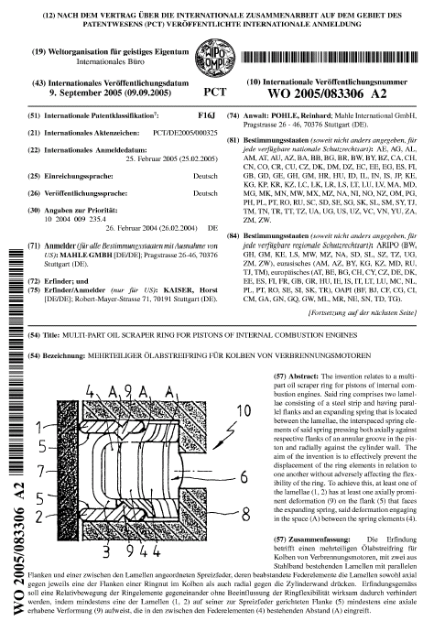
Patent Information:
PCT Publication
International Publication date
International Patent Classification
International Application Number
International Publication Number
International Filing Date
Agent
Filing Language
Publication Language
Priority Data
Designated States
Applicant
Inventor
Title of the Invention
Drawing representing the invention
Abstract

Slide 17
PATENT FILING AND GRANTING PROCEDURES
Based on Patent law and regulations in Kenya:
Industrial Property Act
Industrial Property Regulations
Administrative Instructions
Guidelines for Examination-KIPI

Slide 18
Industrial Property Act
Adopted in 2001
Empowers KIPI) to:
grant patents
register utility models and
register industrial designs

Slide 19
Filing of patent applications
Types of Applications
National (local)
ARIPO (Regional)
PCT (International)
Foreign Direct Filing
KIPI acts as a receiving office (RO) under the PCT

Slide 20
Filing of patent applications
Who can file:
The applicant or
Authorized representative of the applicant

Slide 21
Contents of a Patent Application
A request-IP Form 3
A description;
One or more claims;
One or more drawings (where necessary);
An abstract;
Sequence listing (where necessary)

Slide 22
Examination of Application on Filing
Upon receipt of an application, it is examined by the office and accorded a receiving date (RD)
Filing Date (FD) given if application documents contain:
A request,
A description and
One or more claims
If FD requirements NOT met, applicant invited to correct deficiencies
FD requirements met, receiving date becomes the FD and the applicant is notified.

Slide 23
Formality Examination
Once FD has been accorded, the Office checks compliance with provisions governing:
Form and content of application, the description, claims, declaration of priority, authorization of representative and fees to be paid
Formal requirements not met, applicant invited to correct the defects
Formal requirements met, applicant notified of compliance with formal requirements

Slide 24
Publication of Patent Application
Application published promptly after expiry of 18 months from filing date or
if priority is claimed, from the priority date
Application withdrawn or abandoned before expiry of 18 months from filing date not published
No re-publication of PCT applications entering national phase, Why?
Publication would have been done by the International Bureau of WIPO (IB) during the international phase.

Slide 25
Substantive Examination
Substantive examination not automatic after filing
Carried out upon request
Request should be filed within 3 years from the date of filing
In addition to request for examination, possible to request for expedited / accelerated examination

Slide 26
Search and Search Report
Search performed to establish relevant prior art
Search conducted on the basis of the claims, with due regard to the description and drawings if any
Search report drawn upon conclusion of the search
Search report indicates prior art documents considered necessary for evaluation of novelty and inventive step

Slide 27
Substantive examination
Carried out to determine whether the invention meets patentability requirements
Patentability requirements:
Novelty (new)
Inventive step (non-obvious) and
Industrial applicability
Other matters considered:
Exclusions from patentability, unity of invention, sufficiency of disclosure, public order and morality

Slide 28
Substantive examination
Patentability requirements not met, applicant notified of non-compliance and invited to submit observations and or amendments
Patentability requirements met, applicant notified of decision to grant

Slide 29
Grant and Publication
Notification of decision to grant, is subject to payment of grant and publication fees:
patent granted;
certificate of grant and copy of patent issued to Applicant;
reference to grant is published in the KIPI Journal;
patent recorded in the Patents Register;

Slide 30
Effect of KIPI Patent
Provided it is maintained, patent granted by KIPI is enforceable within the territory of Kenya under the applicable national law
Patent is subject to applicable national law
Duration of a patent - 20 years from filing date

Slide 31
Renewal Fees
Annuity fees required to be paid in respect of a patent application
Fees fall due on the eve of each anniversary of the date of filing
Fees may still be validly paid up to 6 months after due date, provided that a surcharge of the belated renewal fee is paid within the same period
Failure to pay annuities and any additional fee due in time, result in application being deemed to be withdrawn / abandoned; patent deemed to lapse

Slide 32
Appeals
Appeals may be filed before the industrial property tribunal
The tribunal
Considers and decides on any appeal lodged by the applicant;
Reviews any final administrative decision of the Office in relation to the implementation of the IPA
The Tribunal decision is not final, can be challenged in high court

Slide 33
Restoration of Rights
Loss of rights due to applicant or to a patent being unable to observe a time limit
Rights could be restored upon written request subject to meeting certain requirements

Slide 34
END

